Slide 1

Nile’s Customer Service Data Analysis

Slide 2
Business Understanding
Nile has provided their Customer Service data to optimize customer service processes, enhance customer experience, and drive overall business growth also they want to identify patterns, trends, and opportunities for improvement, ultimately leading to enhanced customer loyalty and increased operational efficiency.

Slide 3
Data understanding
Let’s see what data do we have for Analysis.
Customer id, Name, their Sentiments, Satisfaction Score, Date on which the call was made, Reason why the customer called, City, State, Mode of communication, Response time, Call duration, Call Center.
Now, Let’s see what More data do we Need to have for better Analysis.
Gender of Customers, Age, Complete Satisfaction Score of Customers, Profession ( If Possible ).
Data
Format - Excel
Number of Records – 32,941

Slide 4
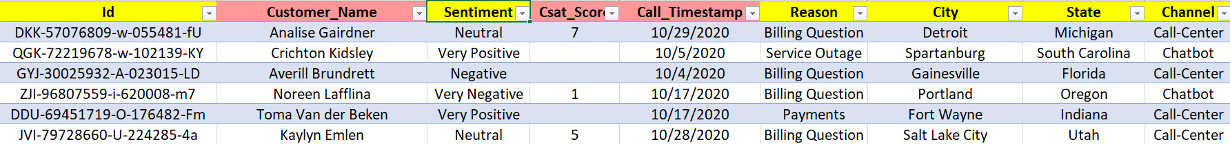
Data preparation
How did i organize the data for modeling?
Checked Duplicate Data Entry. ( Found None )
Ignored Customer’s Name , Call Timestamp.
Ignored Satisfaction Score because it’s Incomplete.

Slide 5
Findings / Evaluation
Customer Sentiment Analysis :-
Out of Total Responses , 51.88 % of customers has given Negative Feedback and just 21.55 & has given Positive Feedback
2. Root Cause Analysis :-
Data has total Three common customer complaints such as : Billing Question, Payments,
Service Outage.
Also, Most common Recurring Complaint is of Billing related Question. Out of total complaints it has share of 71.22 %
Out of Four Call Centres, LA is getting Maximum Number of billing related calls.
One of the Reason for getting more billing related complaints then others could be Vast range of Mode of Communication such as : Call, Chatbot, Mail, Web. Where we do not find such range in other complaints.

Slide 6
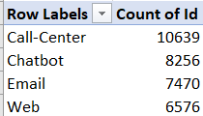
Findings / Evaluation
3. Service Response Time Analysis :-
Overall Complaints resolution falls under WITH-IN SLA Category.
Customer Segmentation :-
Based on Location – Southern States such as – Texas, California, Florida are complaining more then other States. Possible reason could be more Population, More active in complaining their issues then other states
Based on Behaviour :- People are giving Negative and Neutral Response more then the Positive response
Based on Preference :- People are preferring Call Centre more to register their complaint then the other modes as following

Slide 7
Trends and Patterns Identification
If other things remain constant then Negative Sentiments will grow like a monster. Which can hamper Nile’s goodwill in market.
Billing related quarries amounts more then 70% of complaints which shows there are some problems in billing process or department or billing software.
People are approaching Call Centre more frequent to register complaints then other mode of communication. Which shows that customer wants instant resolution of issue rather following complex and passive mode.
Overall Service Level Efficiency is under limit which is good sign but this can be made better.
Average call Time taken by Customer Service team to resolve complaint is 25 Minute

Slide 8
Suggestions For Improvement
Following Suggestions Could be follow to improve :-
Root Cause Handling :-
Get a customer friendly Billing Software
Train The Finance team to register recurring issues wrt to billing and ask them to coordinate with IT team so that team can debug those issues.
Can deploy Artificial Intelligence tool to oversea the whole billing process
Perform a Questionnaire Survey in Texas, Florida, NY, LA to get the real problem feedback and suggestions how Nile can Improve its functioning and prevent future escalations because these states have more billing complaints
2) Efficiency of the customer service team.:-
There is Urgent Need of Hiring more customer service executives in LA and Baltimore call center to handle calls because these call center get around more then 80% calls.
Also, Need to reduce avg call Handling time i.e. 25 minute

Slide 9
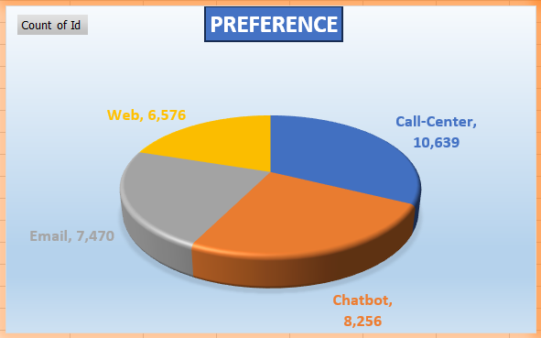
Suggestions For Improvement
Denver and Chicago call center can be merged together because they get very less calls then others also, this staff can be used in other productive tasks.
Need to train Customer service team how they can promote other mode of communication for payment and service outrage issues as these two issues are limited to one or two modes only.
Try to Shuffle staff to one another call centers so that everyone can share their experience and overall productivity can be enhanced.
Customer Segmentation :-
Although Customer Segmentation could have done In better way if Nile would have more categorical data such as – Age, Gender, Profession. So it is advisable to Nile to record these data as well for future reference.
Preferences :-Customer has chosen MOC in following order
Call Centre
Chatbot
Email
Web

Slide 10
Thank You

